Slide 1
Presentation on Inventions Related to Information Technology Before 1940
Student: Jose Sneyder Ortiz Rodriguez

Slide 2
Herman Hollerith's Tabulating Machine (1890)
Date: 1890
Inventor: Herman Hollerith
Place: United States
Description:
Hollerith invented a machine that used punched cards to process data quickly and efficiently. This machine was used in the 1890 U.S. Census, reducing the data processing time from 8 years to just 1 year.

Slide 3

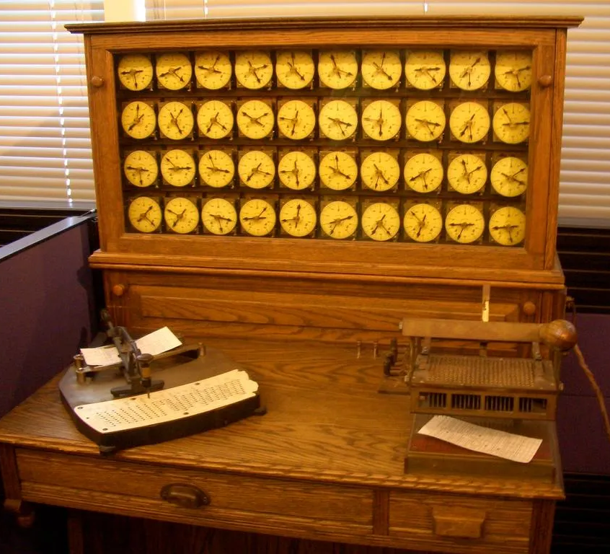
Herman Hollerith's Tabulating Machine (1890)
Fun Facts:
The punched card system inspired the development of modern computing.
Hollerith founded the company that later became IBM.

Slide 4
Charles Babbage's Analytical Engine (1837)
Date: 1837 (conceptual design)
Inventor: Charles Babbage
Place: United Kingdom
Description: Charles Babbage designed the first mechanical computer known as the "Analytical Engine." Although it was never completed during Babbage's lifetime, its design included an arithmetic unit, memory, and the ability to be programmed using punched cards.

Slide 5
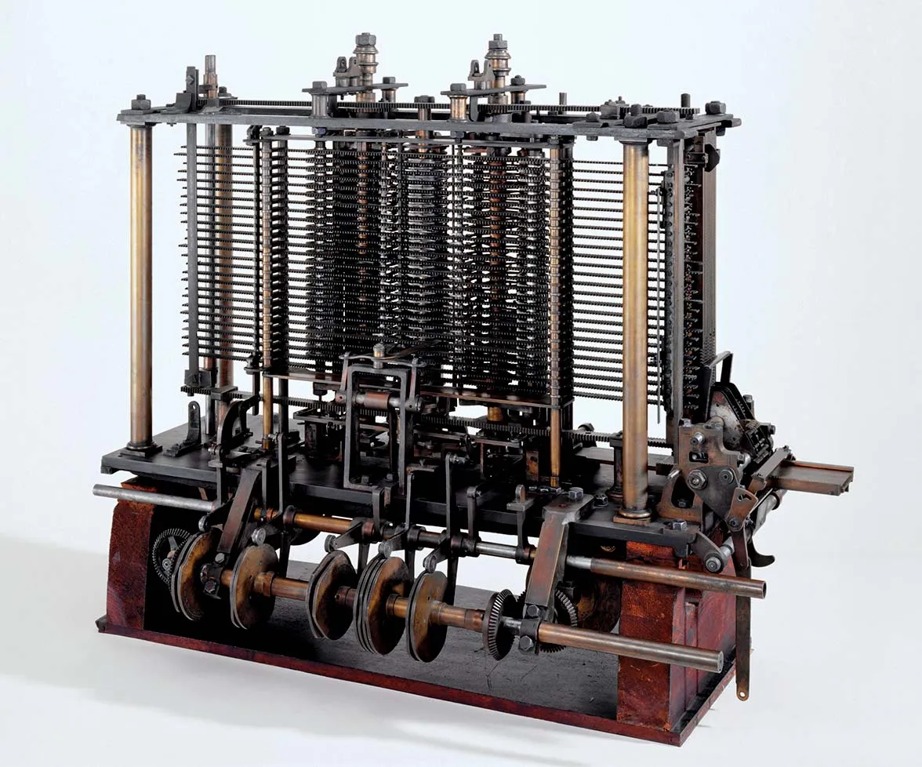
Charles Babbage's Analytical Engine (1837)
Fun Facts:
Ada Lovelace, an English mathematician, wrote what is considered the first algorithm intended to be processed by a machine, becoming the first computer programmer in history.
The "Analytical Engine" is recognized as the precursor to modern computers.

